Slide 1
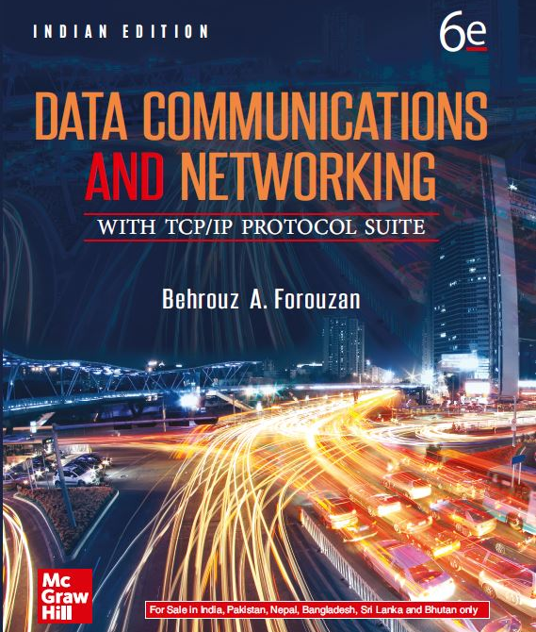
Chapter 05
Wide Area Network: WANs
Data Communications and Networking, With TCP/IP protocol suite Sixth Edition
Behrouz A. Forouzan
© 2022 McGraw Hill, LLC. All rights reserved. Authorized only for instructor use in the classroom.
No reproduction or further distribution permitted without the prior written consent of McGraw Hill, LLC.

Slide 2
Chapter 5: Outline
5.1 Telephone Network
5.2 Cable Network
5.3 Cellular Telephone
5.4 Satellite Network

Slide 3
5-1 TELEPHONE NETWORK
The telephone network had its beginnings in the late 1800s. The entire network was originally an analog system using analog signals to transmit voice. During the last decade, the telephone network has undergone many technical changes. The network is now digital as well as analog.

Slide 4
5.1.1 Major Components
The telephone network is made of three major components: local loops, trunks, and switching offices. The telephone network has several levels of switching offices such as end offices, tandem offices, and regional offices.

Slide 5
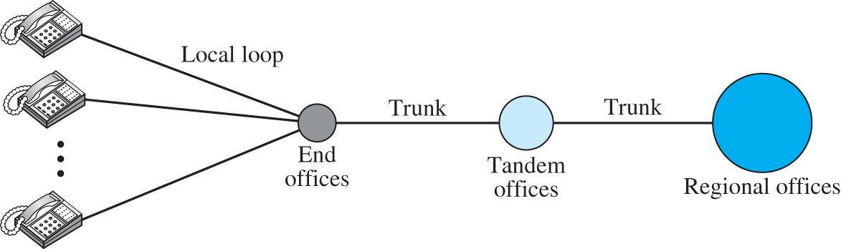
Figure 5.1 A telephone system
Access the text alternative for slide images.

Slide 6
Local Loop
One component of the telephone network is the local loop, a twisted-pair cable that connects the subscriber telephone to the nearest end office or local central office.

Slide 7
Trunks
Trunks are transmission media that handle the communication between offices. A trunk normally handles hundreds or thousands of connections through multiplexing. Transmission is usually through optical fibers or satellite links.

Slide 8
Switching Office
To avoid having a permanent physical link between any two subscribers, the telephone company has switches located in a switching office. A switch connects several local loops or trunks and allows a connection between different subscribers.

Slide 9
5.1.2 LATAs
After the divestiture of 1984, the United States was divided into more than 200 local-access transport areas (LATAs). The number of LATAs has increased since then. A LATA can be a small or large metropolitan area. A small state may have one single LATA; a large state may have several LATAs. A LATA boundary may overlap the boundary of a state; part of a LATA can be in one state, part in another state.

Slide 10
Intra-LATA Service
The services offered by the common carriers (telephone companies) inside a LATA are called intra-LATA services. The carrier that handles these services is called a local exchange carrier (LEC).

Slide 11
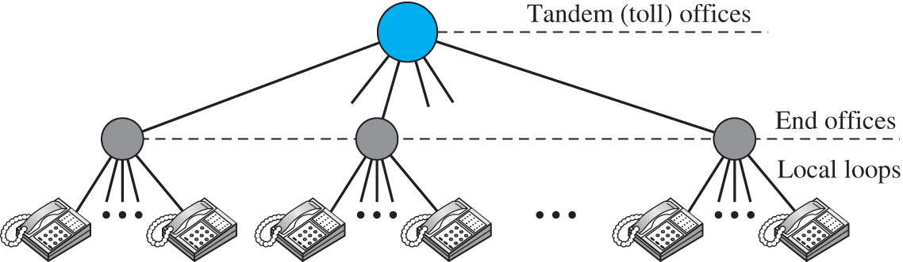
Figure 5.2 Switching offices in a LATA
Access the text alternative for slide images.

Slide 12
Inter-LATA Service
The services between LATAs are handled by interexchange carriers (IXCs). These carriers, sometimes called long-distance companies, provide communication services between two customers in different LATAs. After the act of 1996, these services can be provided by any carrier, including those involved in intra-LATA services. The field is wide open.

Slide 13
Points of Presence
Intra-LATA services can be provided by several LECs. Inter-LATA services can be provided by several IXCs. How do these carriers interact with one another? The answer is, via a switching office called a point of presence (POP).

Slide 14
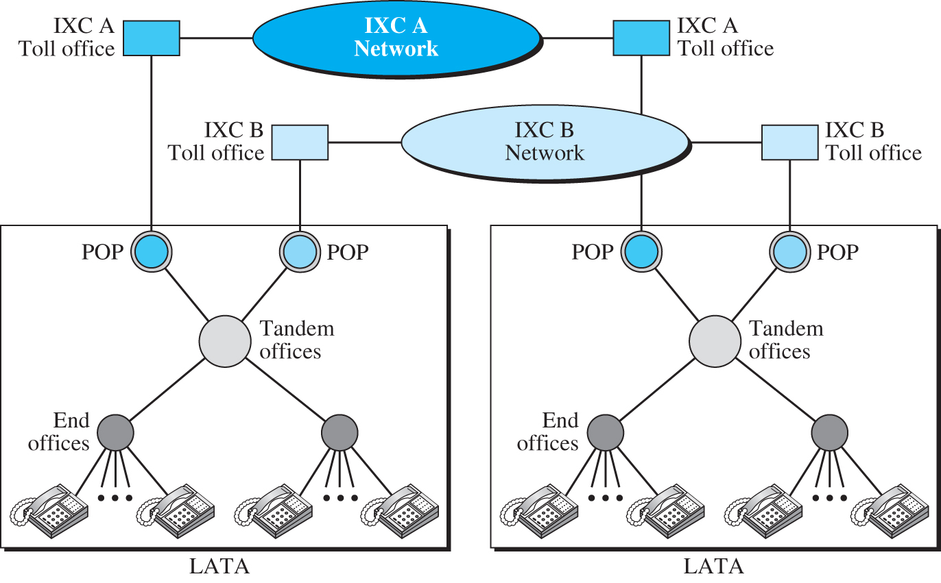
Figure 5.3 Point of presence (POP)
Access the text alternative for slide images.

Slide 15
5.1.3 Signaling
The telephone network, at its beginning, used a circuit-switched network with dedicated links. In the beginning, this task was performed by human operators. Later, the signaling system became automatic. Rotary telephones were invented that sent a digital signal defining each digit in a multidigit telephone number. The switches in the telephone companies used the digital signals to create a connection between the caller and the called parties. Both in-band and out-of-band signaling were used.

Slide 16
Data Transfer Network
The data transfer network that can carry multimedia information today is, for the most part, a circuit-switched network, although it can also be a packet-switched network. This network follows the same type of protocols and model as other networks discussed in this book.

Slide 17
Signaling Network
The signaling network, which is our main concern in this section, is a packet-switched network involving the layers alike to those in the OSI model or Internet model. The nature of signaling makes it more suited to a packet-switching network with different layers.

Slide 18
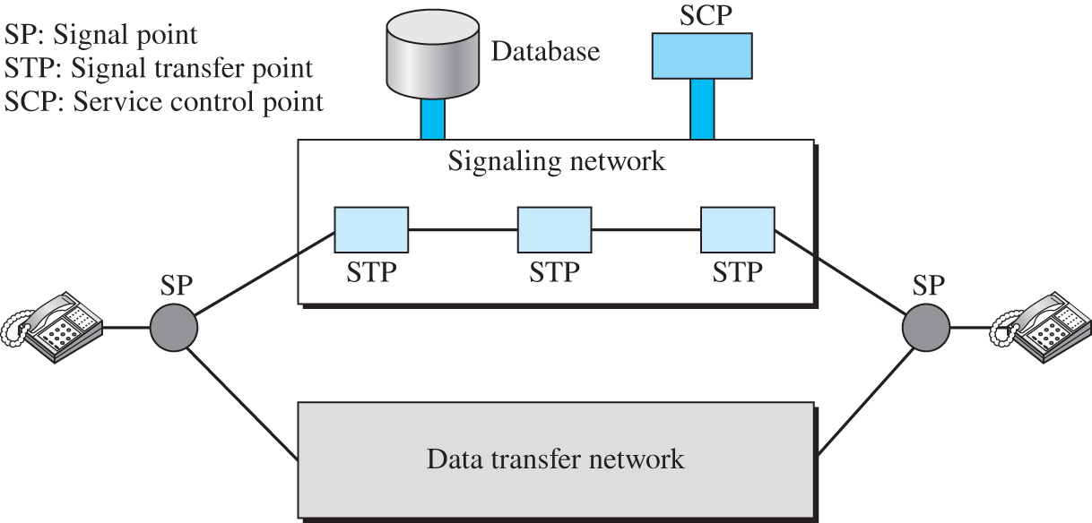
Figure 5.4 Data transfer and signaling networks
Access the text alternative for slide images.

Slide 19
Signaling System Seven (SS7)
The protocol that is used in the signaling network is called Signaling System Seven (SS7). It is very similar to the five-layer Internet model we saw before, but the layers have different names.

Slide 20
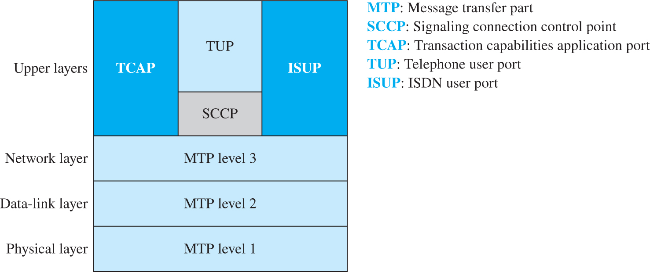
Figure 5.5 Layers in SS7
Access the text alternative for slide images.

Slide 21
5.1.4 Services Provide by Telephone
Telephone companies provide two types of services: analog and digital.

Slide 22
Analog Services
In the beginning, telephone companies provided their subscribers with analog services. These services still continue today. We can categorize these services as either analog switched services or analog leased services.

Slide 23
Digital Services
Later telephone companies began offering digital services to their subscribers. Digital services are less sensitive than analog services to noise and other forms of interference. The two most common digital services are switched/56 service and digital data service (DDS).

Slide 24
5.1.5 Dial-Up Service
Traditional telephone lines can carry frequencies between 300 and 3300 Hz, giving them a bandwidth of 3000 Hz. All this range is used for transmitting voice, where a great deal of interference and distortion can be accepted without loss of intelligibility. As we have seen, however, data signals require a higher degree of accuracy to ensure integrity.

Slide 25
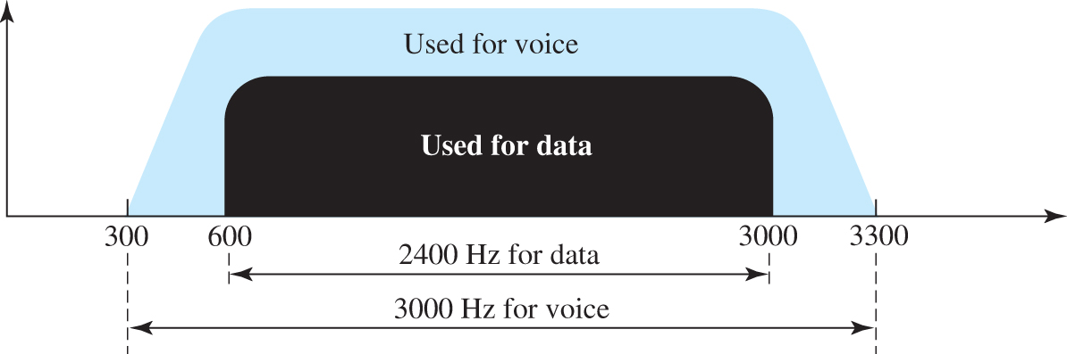
Figure 5.6 Telephone line bandwidth
Access the text alternative for slide images.

Slide 26
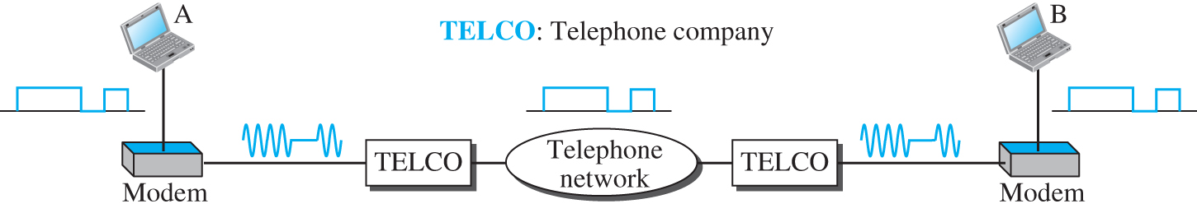
Figure 5.7 Modulation/demodulation
Access the text alternative for slide images.

Slide 27
56K Modems
Traditional modems have a data rate limitation of 33.6 kbps, as determined by the Shannon capacity. However, modern modems with a bit rate of 56,000 bps are available; these are called 56K modems. These modems may be used only if one party is using digital signaling.

Slide 28
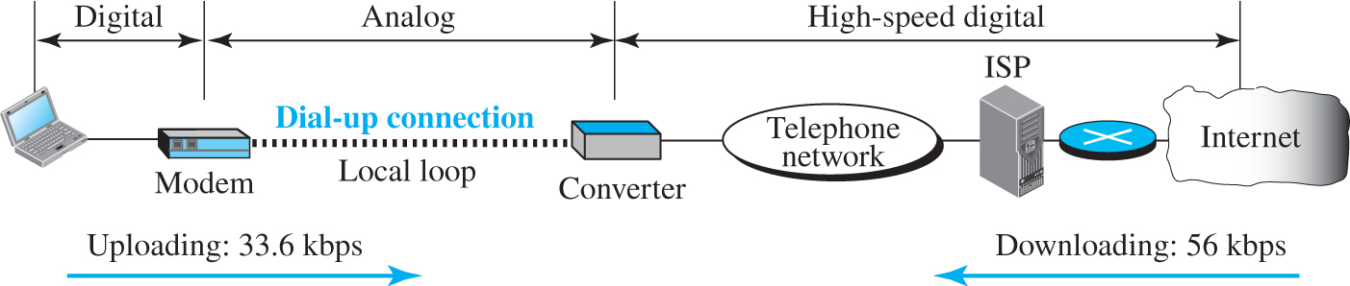
Figure 5.8 Dial-up network to provide Internet services
Access the text alternative for slide images.

Slide 29
5.1.6 Digital Subscriber Line
After traditional modems reached their peak data rate, telephone companies developed another technology, DSL, to provide higher-speed access to the Internet. Digital subscriber line (DSL) technology is one of the most promising for supporting high-speed digital communication over the existing telephone. DSL technology is a set of technologies, each differing in the first letter (ADSL, VDSL, HDSL, and SDSL

Slide 30
Using Existing Local Loop
One interesting point is that ADSL uses the existing telephone lines (local loop). But how does ADSL reach a data rate that was never achieved with traditional modems?

Slide 31
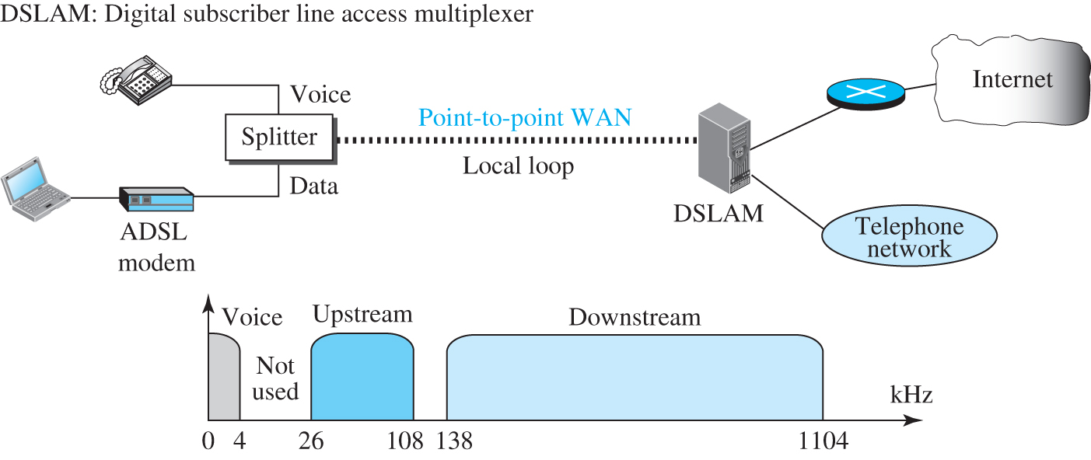
Figure 5.9 ADSL point-to-point network
Access the text alternative for slide images.

Slide 32
5-2 CABLE NETWORK
Cable networks were originally created to provide access to TV programs for those subscribers who had no reception because of natural obstructions such as mountains. Later the cable networks became popular with people who just wanted a better signal. In addition, cable networks enabled access to remote broadcasting stations via microwave connections.

Slide 33
5.2.1 Traditional Cable Network
Cable TV started to distribute broadcast video signals to locations with poor or no reception in the late 1940s. It was called community antenna TV (CATV) because an antenna at the top of a tall hill or building received the signals from the TV stations and distributed them, via coaxial cables, to the community. Figure 5.10 shows a schematic diagram of a traditional cable TV network.

Slide 34
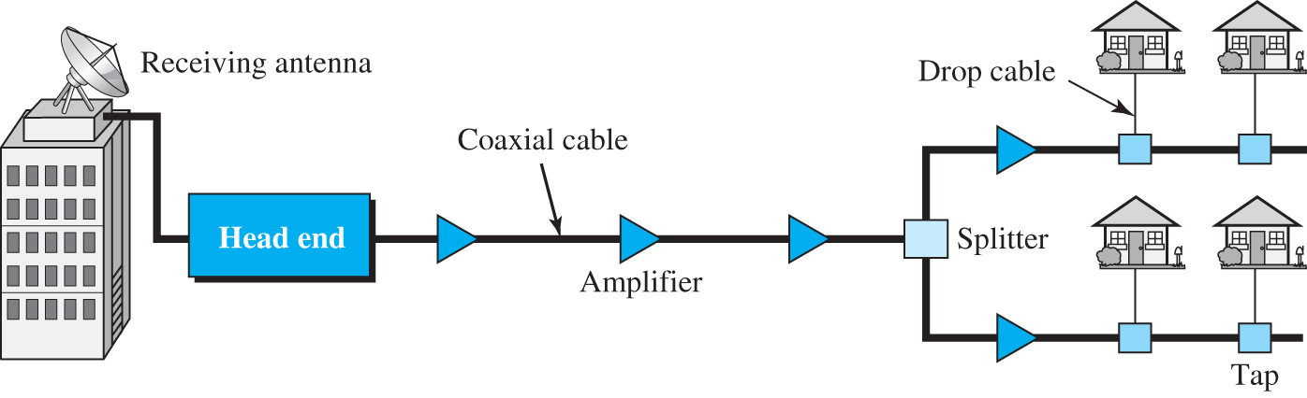
Figure 5.10 Traditional cable TV network
Access the text alternative for slide images.

Slide 35
5.2.2 Hybrid Fiber-Coaxial Network
The second generation of cable networks is called a hybrid fiber-coaxial (HFC) network. The network uses a combination of fiber-optic and coaxial cable. The transmission medium from the cable TV office to a box, called the fiber node, is optical fiber; from the fiber node through the neighborhood and into the house is still coaxial cable. Figure 5.11 shows a schematic diagram of an HFC network.

Slide 36
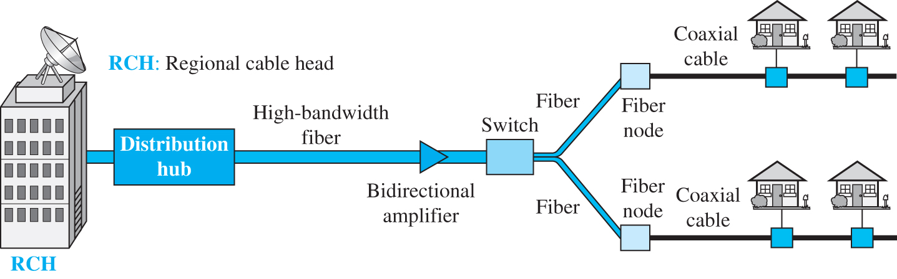
Figure 5.11 Hybrid fiber-coaxial (HFC) network
Access the text alternative for slide images.

Slide 37
5.2.3 Cable TV for Data Transfer
Cable companies are now competing with telephone companies for the residential customer who wants high-speed data transfer. DSL technology provides high-data-rate connections for residential subscribers over the local loop. However, DSL uses the existing unshielded twisted-pair cable, which is very susceptible to interference.

Slide 38
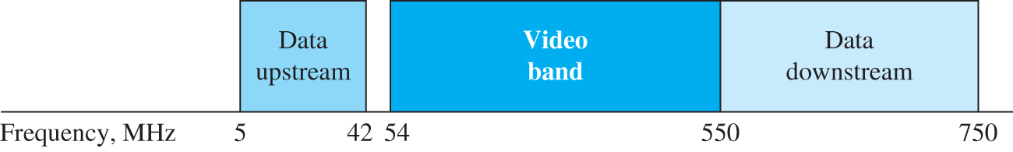
Figure 5.12 Division of coaxial cable band by CATV

Slide 39
Sharing
Both upstream and downstream bands are shared by the subscribers. The upstream data bandwidth is 37 MHz’s. This means that there are only six 6-MHz channels available in the upstream direction. A subscriber needs to use one channel to send data in the upstream direction. The question is, “How can six channels be shared in an area with 1000, 2000, or even 100,000 subscribers?” The solution is time-sharing. The band is divided into channels; these channels must be shared between subscribers in the same neighborhood.

Slide 40
CM and CMTS
To use a cable network for data transmission, we need two key devices: a cable modem (CM) and a cable modem transmission system (CMTS). The cable modem is installed on the subscriber premises. The cable modem transmission system is installed inside the cable company. It receives data from the Internet and sends them to the subscriber. The CMTS also receives data from the subscriber and passes them to the Internet.

Slide 41
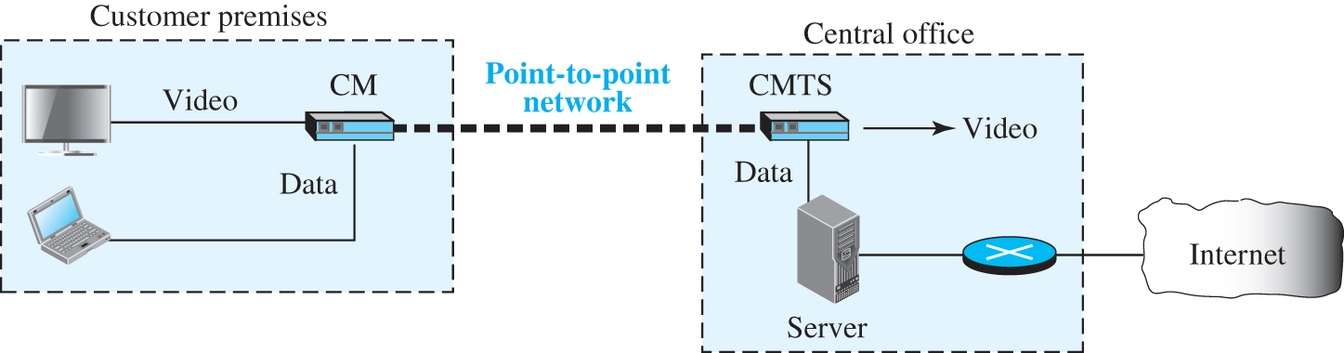
Figure 5.13 Cable modem transmission system (CMTS)
Access the text alternative for slide images.

Slide 42
5-3 CELLULAR TELEPHONY
Cellular telephony is designed to provide communications between two moving units, called mobile stations (MSs), or between one mobile unit and one stationary unit, often called a land unit. A service provider must be able to locate and track a caller, assign a channel to the call, and transfer the channel from base station to base station as the caller moves out of range.

Slide 43
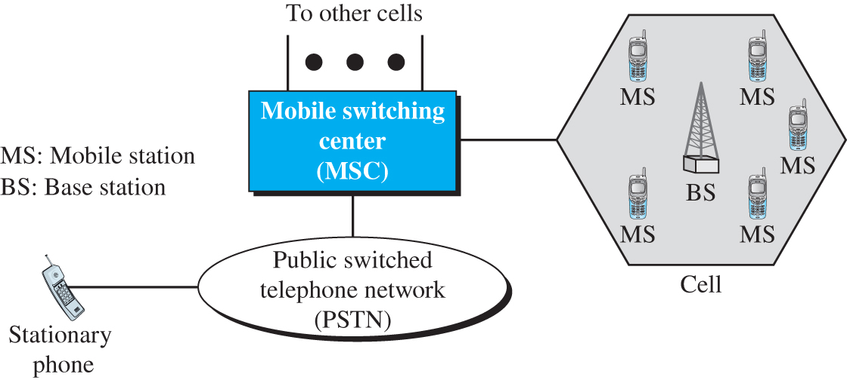
Figure 5.14 Cellular system
Access the text alternative for slide images.

Slide 44
5.3.1 Operation
Let us first briefly discuss the operation of the cellular telephony.

Slide 45
Frequency-Reuse Principle
In general, neighboring cells cannot use the same set of frequencies for communication because it may create interference for the users located near the cell boundaries. However, the set of frequencies available is limited, and frequencies need to be reused. A frequency reuse pattern is a configuration of N cells, N being the reuse factor, in which each cell uses a unique set of frequencies. When the pattern is repeated, the frequencies can be reused. There are several different patterns. Figure 5.15 shows two of them.

Slide 46
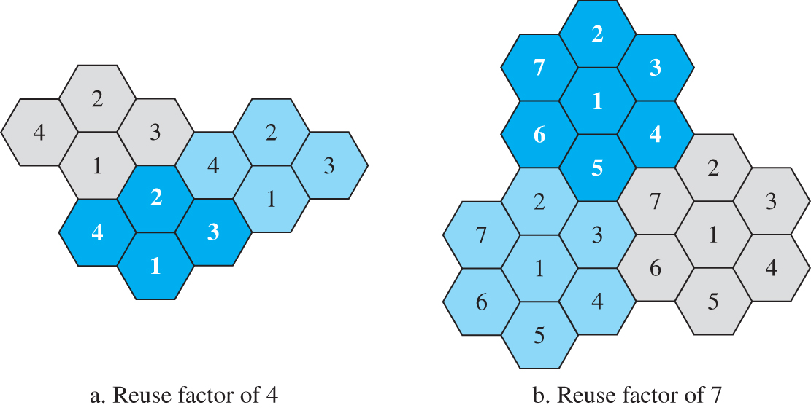
Figure 5.15 Frequency reuse pattern
Access the text alternative for slide images.

Slide 47
Transmitting
To place a call from a mobile station, the caller enters a code of 7 or 10 digits (a phone number) and presses the send button. The mobile station then scans the band, seeking a setup channel with a strong signal, and sends the data (phone number) to the closest base station using that channel. The base station relays the data to the MSC. The MSC sends the data on to the telephone central office.

Slide 48
Receiving
When a mobile phone is called, the telephone central office sends the number to the MSC. The MSC searches for the location of the mobile station by sending query signals to each cell in a process called paging. Once the mobile station is found, the MSC transmits a ringing signal and, when the mobile station answers, assigns a voice channel to the call, allowing voice communication to begin.

Slide 49
Handoff
It may happen that, during a conversation, the mobile station moves from one cell to another. When it does, the signal may become weak. To solve this problem, the MSC monitors the level of the signal every few seconds. If the strength of the signal diminishes, the MSC seeks a new cell that can better accommodate the communication. The MSC then changes the channel carrying the call (hands the signal off from the old channel to a new one).

Slide 50
Roaming
One feature of cellular telephony is called roaming. Roaming means, in principle, that a user can have access to communication or can be reached where there is coverage. A service provider usually has limited coverage. Neighboring service providers can provide extended coverage through a roaming contract. The situation is similar to snail mail between countries. The charge for delivery of a letter between two countries can be divided upon agreement by the two countries.

Slide 51
5.3.2 First Generation (1G)
Cellular telephony is now in its fourth generation. The first generation was designed for voice communication using analog signals. We discuss one first-generation mobile system used in North America, AMPS.

Slide 52
AMPS
Advanced Mobile Phone System (AMPS) is one of the leading analog cellular systems in North America. It uses FDMA to separate channels in a link.

Slide 53
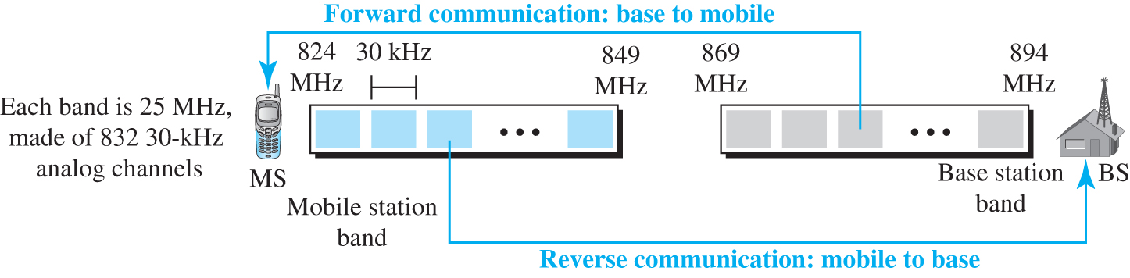
Figure 5.16 Cellular bands for AMPs
Access the text alternative for slide images.

Slide 54
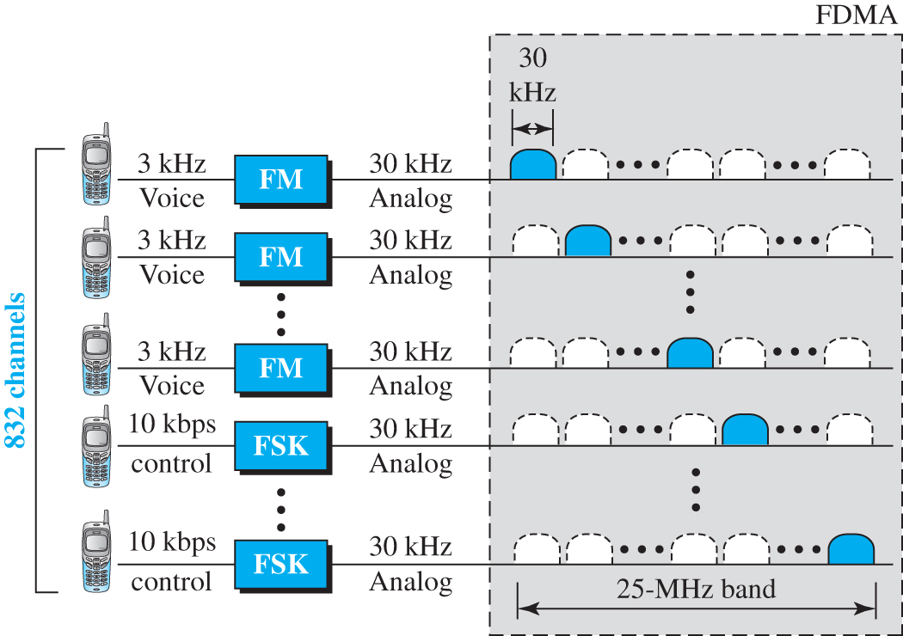
Figure 5.17 AMPS reverse communication band
Access the text alternative for slide images.

Slide 55
5.3.3 Second Generation (2G)
To provide higher-quality (less noise-prone) mobile voice communications, the second generation of the cellular phone network was developed. While the first generation was designed for analog voice communication, the second generation was mainly designed for digitized voice. Three major systems evolved in the second generation: D-AMPS, GSM, and CDMA.

Slide 56
D-AMPS
The product of the evolution of the analog AMPS into a digital system is digital AMPS (D-AMPS). D-AMPS was designed to be backward-compatible with AMPS. This means that in a cell, one telephone can use AMPS and another D-AMPS. D-AMPS was first defined by IS-54 (Interim Standard 54) and later revised by IS-136.

Slide 57
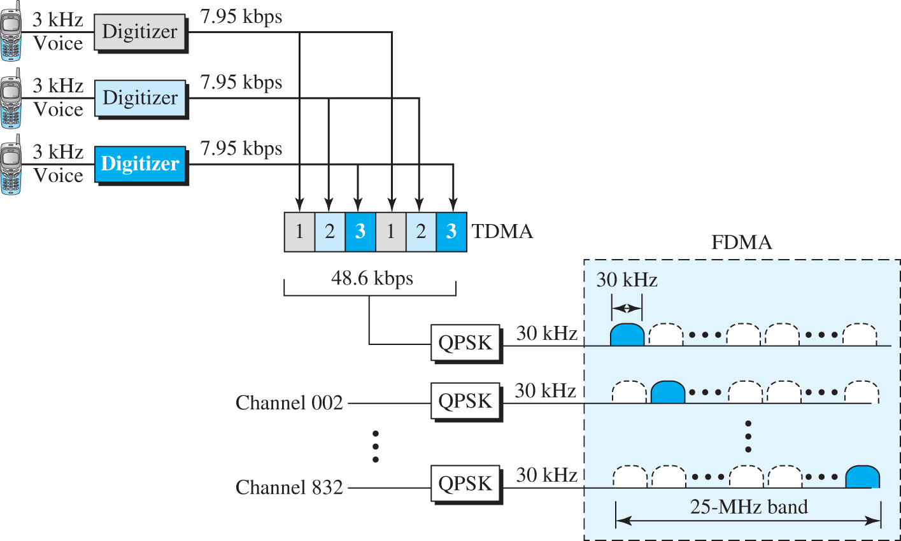
Figure 5.18 D-AMPS
Access the text alternative for slide images.

Slide 58
GMS
The Global System for Mobile Communication (GSM) is a European standard that was developed to provide a common second-generation technology for all Europe. The aim was to replace a number of incompatible first-generation technologies.

Slide 59
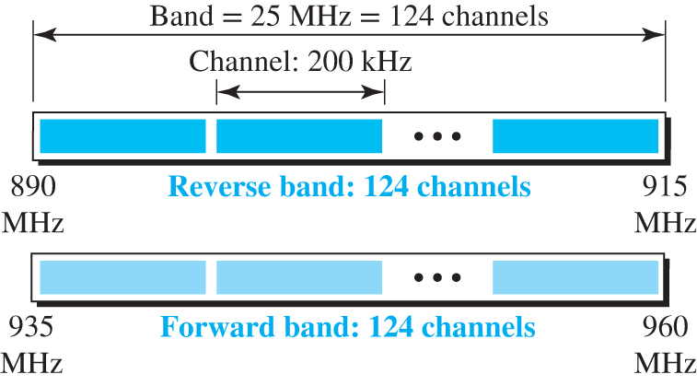
Figure 5.19 GSM bands
Access the text alternative for slide images.

Slide 60
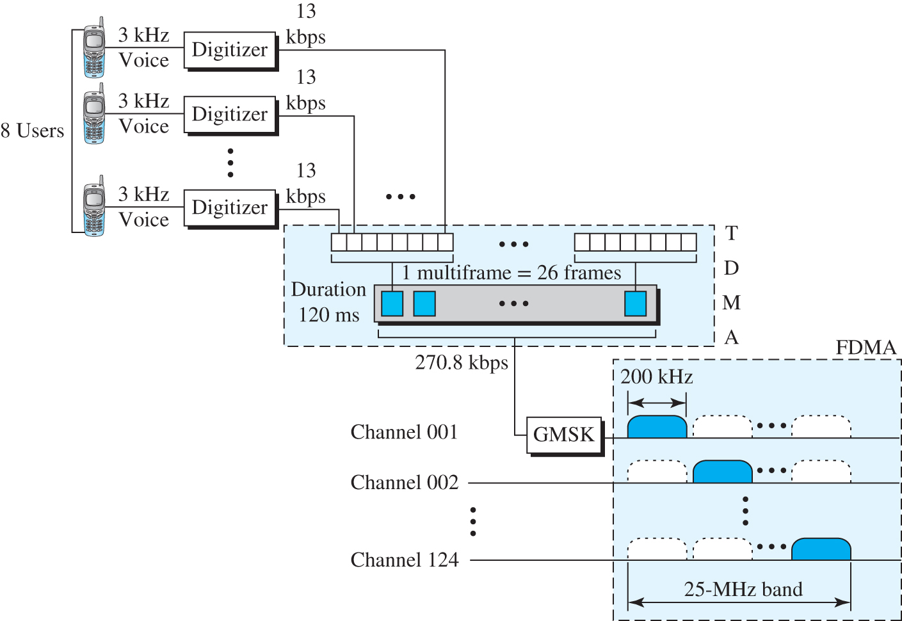
Figure 5.20 GSM
Access the text alternative for slide images.

Slide 61
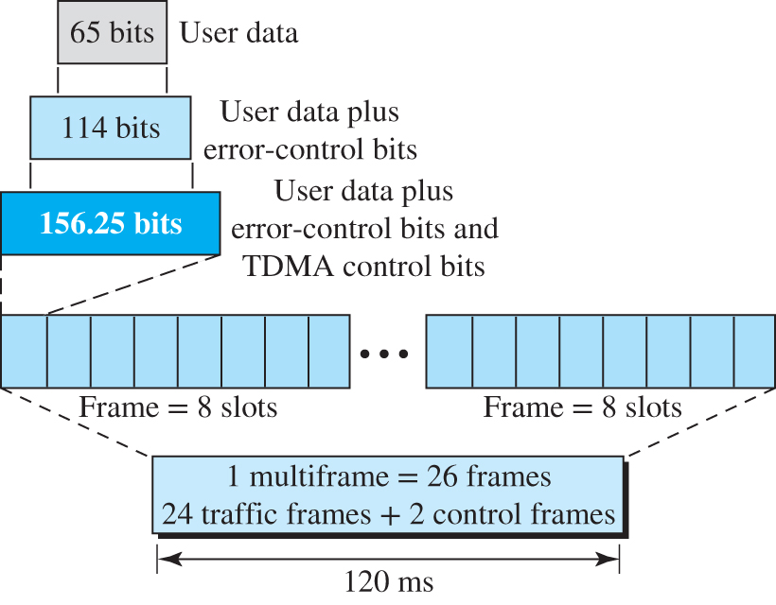
Figure 5.21 Multiframe components
Access the text alternative for slide images.

Slide 62
IS-95
One of the dominant second-generation standards in North America is Interim-Standard 95 (IS-95). It is based on CDMA and DSSS.

Slide 63
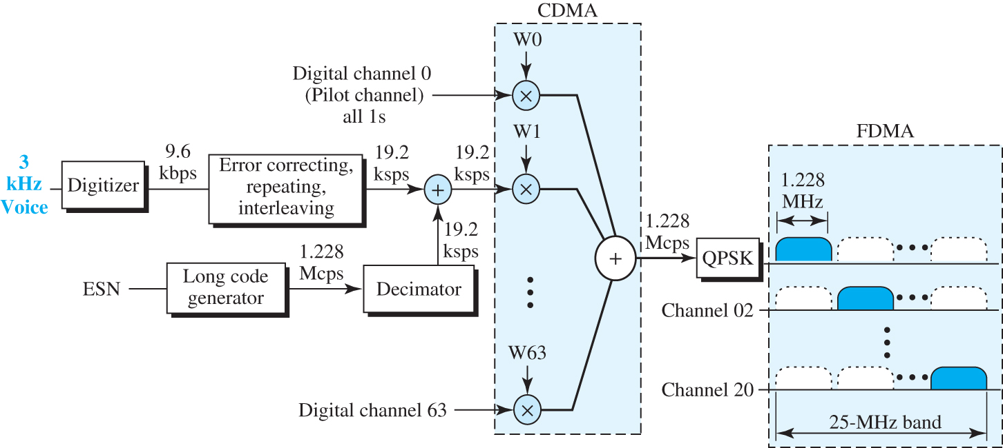
Figure 5.22 IS-95 forward transmission
Access the text alternative for slide images.

Slide 64
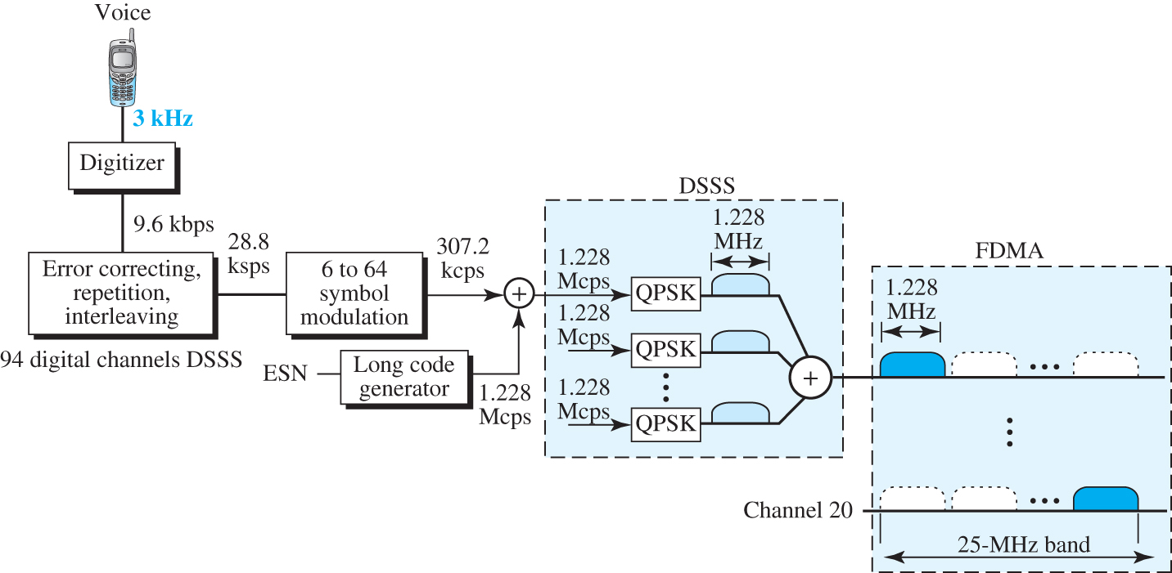
Figure 5.23 IS95 reverse transmission
Access the text alternative for slide images.

Slide 65
5.3.4 Third Generation
The third generation of cellular telephony refers to a combination of technologies that provide both digital data and voice communication. Using a small portable device, a person is able to talk to anyone else in the world with a voice quality similar to that of the existing fixed telephone network.

Slide 66
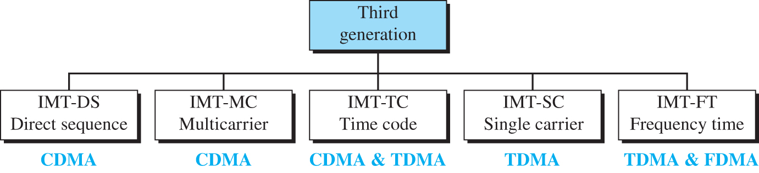
Figure 5.24 IMT-2000 radio interface
Access the text alternative for slide images.

Slide 67
5.3.5 Fourth Generation
The fourth generation of cellular telephony is expected to be a complete evolution in wireless communications. Some of the objectives defined by the 4G working group are discussed later.

Slide 68
Access Scheme
To increase efficiency, capacity, and scalability, new access techniques are being considered for 4G. For example, orthogonal FDMA (OFDMA) and interleaved FDMA (IFDMA) are being considered respectively for the downlink and uplink of the next generation Universal Mobile Telecommunications System (UMTS). Similarly, multi-carrier code division multiple access (MC-CDMA) is proposed for the IEEE 802.20 standard.

Slide 69
Modulation
More efficient quadrature amplitude modulation (64-QAM) is being proposed for use with the Long-Term Evolution (LTE) standards.

Slide 70
Radio System
The fourth generation uses a Software Defined Radio (SDR) system. Unlike a common radio that uses hardware, the components of an SDR are pieces of software and thus flexible. The SDR can change its program to shift its frequencies to mitigate frequency interference.

Slide 71
Antenna
The multiple-input multiple-output (MIMO) and multi-user MIMO (MU-MIMO) antenna system, a branch of intelligent antenna, is proposed for 4G. Using this antenna system together with special multiplexing, 4G allows independent streams to be transmitted simultaneously from all the antennas to increase the data rate into multiple folds. MIMO also allows the transmitter and receiver coordinates to move to an open frequency when interference occurs.

Slide 72
Application
A satellite network is a combination of nodes, some of which are satellites, that provides communication from one point on the Earth to another. A node in the network can be a satellite, an Earth station, or an end-user terminal or telephone.

Slide 73
5-4 SATELITE NETWORK
A satellite network is a combination of nodes, some of which are satellites, that provides communication from one point on the Earth to another. A node in the network can be a satellite, an Earth station, or an end-user terminal or telephone.

Slide 74
5.4.1 Operation
Let us first discuss some general issue related to the operation of satellites.

Slide 75
Orbits
An artificial satellite needs to have an orbit, the path in which it travels around the Earth. The orbit can be equatorial, inclined, or polar, as shown in Figure 5.25.

Slide 76
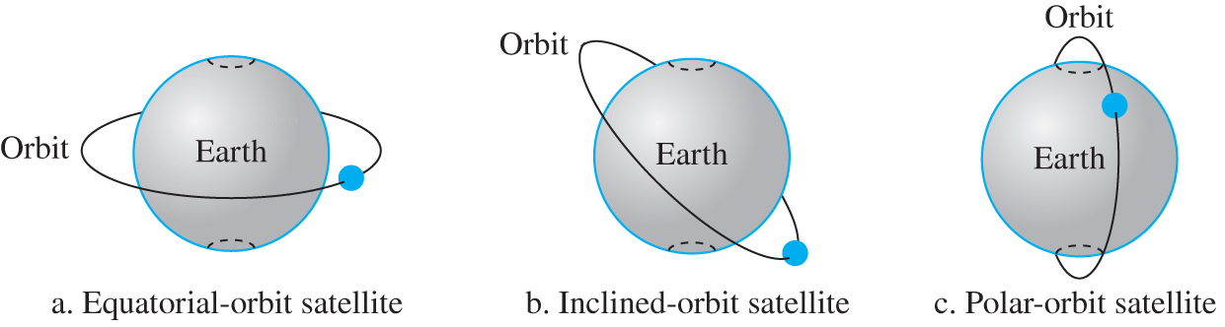
Figure 5.25 Satellite orbits
Access the text alternative for slide images.

Slide 77
Example 5.1
What is the period of the moon, according to Kepler’s law?
Here C is a constant approximately equal to 1/100. The period is in seconds and the distance in kilometers.
Solution
Applying the formula, we get the following.

Slide 78
Example 5.2
What is the period of a satellite that is located at an orbit approximately 37865 Km above the Earth?
Solution
Applying the formula, we get the following.
This means that a satellite located at 35,786 km has a period of 24 hours.

Slide 79
Footprint
Satellites process microwaves with bidirectional antennas (line-of-sight). Therefore, the signal from a satellite is normally aimed at a specific area called the footprint. The signal power at the center of the footprint is maximum. The power decreases as we move out from the footprint center. The boundary of the footprint is the location where the power level is at a predefined threshold.

Slide 80
Frequency Band for Satellite Communication
The frequencies reserved for satellite microwave communication are in the gigahertz (GHz) range. Each satellite sends and receives over two different bands. Transmission from the Earth to the satellite is called the uplink. Transmission from the satellite to the Earth is called the downlink.

Slide 81
Three Categories of Satellites
Based on the location of the orbit, satellites can be divided into three categories: geostationary Earth orbit (GEO), low-Earth-orbit (LEO), and medium-Earth-orbit (MEO).

Slide 82
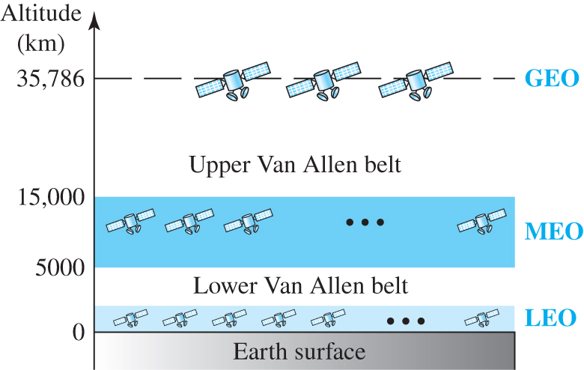
Figure 5.26 Satellite orbit altitudes
Access the text alternative for slide images.

Slide 83
5.4.2 GEO Satellite
Line-of-sight propagation requires that the sending and receiving antennas be locked onto each other’s location at all times. For this reason, a satellite that moves faster or slower than the Earth’s rotation is useful only for short periods. To ensure constant communication, the satellite must move at the same speed as the Earth so that it seems to remain fixed above a certain spot. Such satellites are called geostationary.

Slide 84
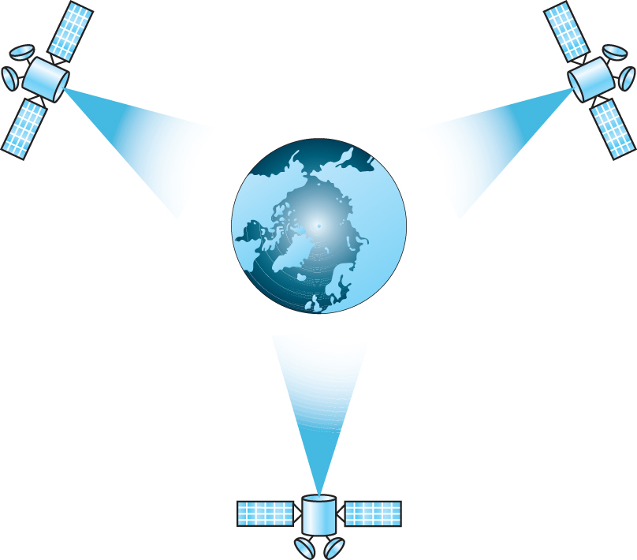
Figure 5.27 Satellites in geostationary orbit

Slide 85
5.4.3 MEO Satellite
Medium-Earth-orbit (MEO) satellites are positioned between the two Van Allen belts. A satellite at this orbit takes approximately 6 to 8 hours to circle the Earth.

Slide 86
Global Positioning System
One example of a MEO satellite system is the Global Positioning System (GPS), contracted and operated by the U.S. Department of Defense, orbiting at an altitude about 18,000 km (11,000 mi) above the Earth.

Slide 87
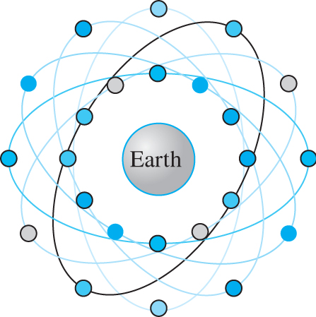
Figure 5.28 Orbits for global positioning system

Slide 88
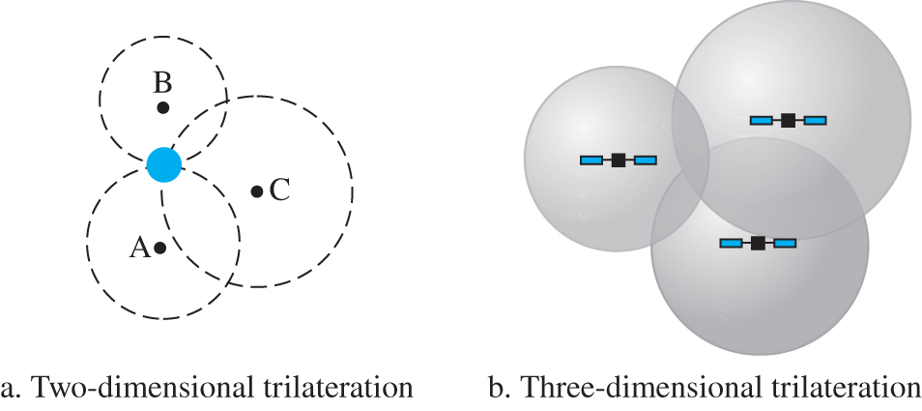
Figure 5.29 Trilateration on a plane
Access the text alternative for slide images.

Slide 89
5.4.4 LEO Satellite
Low-Earth-orbit (LEO) satellites have polar orbits. The altitude is between 500 and 2000 km, with a rotation period of 90 to 120 min. The satellite has a speed of 20,000 to 25,000 km/h. A LEO system usually has a cellular type of access, similar to the cellular telephone system. The footprint normally has a diameter of 8000 km.

Slide 90
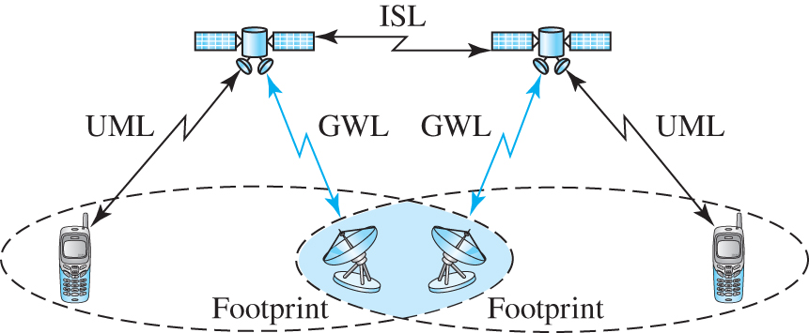
Figure 5.30 Leo Satellite
Access the text alternative for slide images.

Slide 91
End of Main Content
© 2022 McGraw Hill, LLC. All rights reserved. Authorized only for instructor use in the classroom.
No reproduction or further distribution permitted without the prior written consent of McGraw Hill, LLC.

Slide 92
Accessibility Content: Text Alternatives for Images

Slide 93
Figure 5.1 A telephone system - Text Alternative
Return to parent-slide containing images.
A figure shows several telephones passing signals to end offices by local loops. The end office connects to tandem offices and then to regional offices through trunks.
Return to parent-slide containing images.

Slide 94
Figure 5.2 Switching offices in a LATA - Text Alternative
Return to parent-slide containing images.
An illustration shows that the signals from tandem (toll) offices connect to multiple end offices. The end offices connect to various telephones by local loops.
Return to parent-slide containing images.

Slide 95
Figure 5.3 Point of presence (POP) - Text Alternative
Return to parent-slide containing images.
The I X C A network connects with two I X C A toll offices. One I X C A toll office connects to the point of presence (P O P) of L A T A, where the P O P connects to tandem offices and End offices and telephones. Another I X C A toll office connects to the I X C B network. The I X C B network connects to two I X C B toll offices. The first I X C B toll office connects to another P O P of first L A T A which then connects to tandem offices to end offices to telephones. The I X C A toll office connects to the I X C B network that connects to the P O P of the second L A T A. The I X C B toll office connects to another P O P of second L A T A. The two P O P connect to tandem offices to end offices to telephones.
Return to parent-slide containing images.

Slide 96
Figure 5.4 Data transfer and signaling networks - Text Alternative
Return to parent-slide containing images.
A block diagram shows a signaling network and the data transfer network connected via signal points that are in turn connected to telephones. The signaling network has three signal transfer points in series. A database and a service control point are connected to the signaling network on top.
Return to parent-slide containing images.

Slide 97
Figure 5.5 Layers in SS7 - Text Alternative
Return to parent-slide containing images.
An illustration shows the SS 7 layers. The layers from bottom to top are as follows. The physical layer represents message transfer part level 1, the data-link layer represents message transfer part level 2, the network layer represents message transfer part level 3, and the upper layers represent transaction capabilities application port, telephone user port on top, and signaling connection control point on the bottom, and I S D N user port.
Return to parent-slide containing images.

Slide 98
Figure 5.6 Telephone line bandwidth - Text Alternative
Return to parent-slide containing images.
A graph with the x-axis representing bandwidth is shown. The graph shows 2400 Hertz is used for data that ranges between 600 and 3000 hertz and 3000 Hertz are used for the voice that ranges between300 and 3300 hertz.
Return to parent-slide containing images.

Slide 99
Figure 5.7 Modulation/demodulation - Text Alternative
Return to parent-slide containing images.
The signal from laptop A passes to the modem then to a telephone company (T E L C O). The telephone company connects to the telephone network to T E L C O and then to the modem. From the modem, it reaches a laptop B.
Return to parent-slide containing images.

Slide 100
Figure 5.8 Dial-up network to provide Internet services - Text Alternative
Return to parent-slide containing images.
A figure shows a laptop that passes the digital signal to the modem. Using a dial-up connection by the local loop, the analog signal from the modem is connected to a converter. From the converter, the high-speed digital data passes to the telephone network, then to an internet service provider, and to the internet via a router. The arrows below indicate uploading 33.6 kilobits per second from the laptop and downloading 56 kilobits per second from the internet.
Return to parent-slide containing images.

Slide 101
Figure 5.9 ADSL point-to-point network - Text Alternative
Return to parent-slide containing images.
A block diagram for the ASDL point-to-point network is shown. A voice signal from the telephone and the data from a laptop to the Asymmetric Digital Subscriber Line modem passes to the splitter. The splitter connects to a digital subscriber line access multiplexer (DSLAM) through a local loop point-to-point wide area network. The DSLAM connects to a telephone network and a router that connects to the internet. A graph shows a voice signal from 0 to 4 kilohertz, 4 to 26 kilohertz are not used, upstream from 26 to 108 kilohertz, and downstream from 138 to 1104 kilohertz.
Return to parent-slide containing images.

Slide 102
Figure 5.10 Traditional cable TV network - Text Alternative
Return to parent-slide containing images.
An illustration shows the signal from the receiving antenna passes to the head end through a coaxial cable. The head end is connected to a series of three amplifiers and then to a splitter. The splitter splits the signal into two and amplifies it and delivers to series of taps. Each tap connects to individual homes via drop cables.
Return to parent-slide containing images.

Slide 103
Figure 5.11 Hybrid fiber-coaxial (HFC) network - Text Alternative
Return to parent-slide containing images.
An illustration shows a hybrid fiber-coaxial network. The signal from the regional cable head passes to a distribution hub that is connected to a bidirectional amplifier and then to a switch through a high-bandwidth fiber. The switch connects to two fiber nodes from which, the signal is delivered to individual homes through coaxial cable.
Return to parent-slide containing images.

Slide 104
Figure 5.13 Cable modem transmission system (CMTS) - Text Alternative
Return to parent-slide containing images.
An illustration shows a customer premises that has a cable modem (CM) that delivers data to a laptop and video to a television. The cable modem connects to a Cable Modern Transmission System in the central office through the point-to-point network. The CMTS delivers video and gathers data from the server that is connected to the internet via a router.
Return to parent-slide containing images.

Slide 105
Figure 5.14 Cellular system - Text Alternative
Return to parent-slide containing images.
An illustration shows a signal from the stationary phone enters the public switched telephone network (P S T N), from which the signal is passed to mobile switching center (M S C) to other cells. The mobile switching center is connected to a cell which has one base station and five mobile stations.
Return to parent-slide containing images.

Slide 106
Figure 5.15 Frequency reuse pattern - Text Alternative
Return to parent-slide containing images.
The reuse factor four represents closely packed hexagonal shapes in three colors with four in each color that are labeled 1 2 3 4. The reuse factor of seven represents closely packed hexagonal shapes in three colors with seven in each color that are labeled 1 2 3 4 5 6 7.
Return to parent-slide containing images.

Slide 107
Figure 5.16 Cellular bands for AMPs - Text Alternative
Return to parent-slide containing images.
An illustration shows a mobile station band ranging from 824 megahertz to 849 megahertz and a base station band from 869 megahertz to 894 megahertz. Each band is 25 Megahertz, made of 832 30-Kilohertz analog channels. Forward communication represents the transmission of a signal from the base station to the mobile station. The reverse communication represents transmission of a signal from mobile station band to base station band.
Return to parent-slide containing images.

Slide 108
Figure 5.17 AMPS reverse communication band - Text Alternative
Return to parent-slide containing images.
A block diagram shows a total of 832 channels with a voice signal of 3-kilohertz and a control signal of 10 kilobits per second from the channels are send to separate Frequency Modulators. An output of 30 kilohertz analog from each frequency modulator is send to FDMA. The FDMA produces a total band of 25 megahertz for each 30 kilohertz analog signal. The single band in each channel is 30 kilohertz.
Return to parent-slide containing images.

Slide 109
Figure 5.18 D-AMPS - Text Alternative
Return to parent-slide containing images.
The D-AMPS block diagram includes data flow from digitizer to time division multiple access (TDMA), to quadrature phase shift keying (QPSK), and to frequency division multiple access (FDMA). A voice signal of 3-kilohertz from three users is sent to three digitizers that produce 7.95-kilobits per second. Each digitizer output belongs to a slot of a frame in TDMA. The frame measures 48.6 kilobits per second, which is send to QPSK in 832 channels, each produces 30 kilohertz output. Each output is send to each channel in FDMA. Each channel is of 25 megahertz band. The single band in each channel measures 30 kilohertz.
Return to parent-slide containing images.

Slide 110
Figure 5.19 GSM bands - Text Alternative
Return to parent-slide containing images.
The reverse band and the forward band has 124 channels with a total bandwidth of 25 megahertz. Each channel measures 200 kilohertz. The reverse band ranges between 890 Megahertz and 915 Megahertz and the forward band ranges between 935 Megahertz and 960 Megahertz.
Return to parent-slide containing images.

Slide 111
Figure 5.20 GSM - Text Alternative
Return to parent-slide containing images.
The G S M block diagram includes data flow from digitizer to time division multiple access (TDMA), and to frequency division multiple access (FDMA). A voice signal of 3-kilohertz from each user is sent to a digitizer that produces 13-kilobits per second. Each digitizer output belongs to each slot of a frame in TDMA. 26 such frames form a multiframe of 120 milliseconds long. The 270.8 kilobits per second output from TDMA is send to Gaussian Minimum Shift Keying, GMSK, which is subjected to FDMA. It produces 124 channels each with a total of 25 megahertz band. The single band in each channel measures 200 kilohertz.
Return to parent-slide containing images.

Slide 112
Figure 5.21 Multiframe components - Text Alternative
Return to parent-slide containing images.
A multiframe of 120 milliseconds equals 26 frames, where 24 are traffic frames and the remaining two are control frames. A frame equals 8 slots. A slot represents 156.25 bits that includes user data plus error-control bits and T D M A control bits. In the 156.25 bits, 114 bits represent user data plus error-control bits. In 114 bits, 65 bits represent user data.
Return to parent-slide containing images.

Slide 113
Figure 5.22 IS-95 forward transmission - Text Alternative
Return to parent-slide containing images.
In the block diagram, a voice signal of 3-kilohertz is passed to a digitizer that produces an output of 9.6 kilobits per second. This output is subjected to error-correcting, repeating, and interleaving and produces an output of 19.2 kilo symbols per second which is given to an adder. An ESN signal is sent to long code generator that produces 1.228 mega counts per second, which is send to a decimator and produces an output of 19.2 kilo symbols per second. This output is send to the adder. The adder output, 19.2 kilo symbols per second is given as input to one of the multipliers in code division multiple access. It has 63 digital channel multipliers. The output from all the channels is send to an adder that produces 1.228 mega counts per second. The output is subjected to quadrature phase shift keying that further connects to frequency division multiple accessing process. It produces 20 channels each with a total of 25 megahertz band. The single band in each channel measures 1.228 megahertz.
Return to parent-slide containing images.

Slide 114
Figure 5.23 IS95 reverse transmission - Text Alternative
Return to parent-slide containing images.
In the block diagram, a voice signal of 3 kilohertz passes through a digitizer that produces an output of 9.6 kilobits per second. This output is sent for Error-correcting, repetition, interleaving with 94-digital channels D S S S. It produces an output of 28.8 kilo symbols per second which is then sent to a 6 to 64 symbol modulation block. It gives an output of 307.2 kilo counts per second. This output along with a data of 1.228 Mega chips per second produced from a long code generator are sent to an adder. The 1.228 mega chips per second data is send to multiple quadrature phase shift keying blocks present in a direct sequence spread spectrum. Each produces an output of 1.228 megahertz that are added and subjected to frequency division multiple accessing process. It produces 20 channels each with a total of 25 megahertz band. The single band in each channel measures 1.228 megahertz.
Return to parent-slide containing images.

Slide 115
Figure 5.24 IMT-2000 radio interface - Text Alternative
Return to parent-slide containing images.
The third generation mobile system includes the following interfaces: I M T – D S direct sequence (C D M A), I M T- M C multicarrier (C D M A), I M T – T C (time code) (C D M A and T D M A), I M T – S C single carrier (T D M A) and I M T-F T frequency-time (T D M A and F D M A).
Return to parent-slide containing images.

Slide 116
Figure 5.25 Satellite orbits - Text Alternative
Return to parent-slide containing images.
Three satellite orbits are shown. The equatorial-orbit satellite revolves around earth along the line of equator. An Inclined-orbit satellite rotates around the Earth in an inclined path, exhibiting an angle to the equatorial plane. The Polar orbit satellite rotates the earth by passing above the two poles.
Return to parent-slide containing images.

Slide 117
Figure 5.26 Satellite orbit altitudes - Text Alternative
Return to parent-slide containing images.
A graph shows the altitudes of satellite orbits from the earth's surface. The vertical axis represents the altitude in kilometers. The lower Van Allen belt L E O region ranges from the earth's surface till 2000 kilometers (approximately). The upper Van Allen belt M E O region lies between 5000 and 15000 kilometers. The G E O is at 35786 kilometers from the earth's surface.
Return to parent-slide containing images.

Slide 118
Figure 5.29 Trilateration on a plane - Text Alternative
Return to parent-slide containing images.
A figure (a) depicts two dimensional trilateration, in which three circles with points A, B, and C are shown intersecting at a point. The circle with point C intersects the circles with points A and B at two points. A figure (b) shows three spheres intersecting at a common region. Each sphere intersect each other at two points.
Return to parent-slide containing images.

Slide 119
Figure 5.30 Leo Satellite - Text Alternative
Return to parent-slide containing images.
A figure shows two satellites connected by an intersatellite link. The satellites have their own footprints and connects with a cellular phone by U M L and a satellite dish by G W L.
Return to parent-slide containing images.

